Slide 1
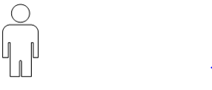
Mobile Device
Operating System
Biometrics API layer
Display
Display provides visual
Feedback to the User of the
Biometrics System
Biometric System
Is called from OS
And provides results
Secure Data Storage
Biometric Templates
Storage and Access
User provides biometrics
Biometric System gathers samples,
enrolls templates, and
matches samples to templates
Biometric
Sensor(s)
TOE – Biometric System

